Slide 1

A Comparative Study of Methods for Mitigating Catastrophic Forgetting in Neural Networks Continual Learning
Final Review
Course Code: CS7510
Course Title: Project 2
24MSP3038
Aniket Shinde
19/03/2025

Slide 2
Abstract
Neural networks experience catastrophic forgetting, where learning new tasks erases previously acquired knowledge. This project compares three approaches to mitigate this issue: Regularization-Based Methods, Replay-Based Methods, and Architectural Methods. Using the Split-MNIST dataset, we evaluate these techniques under Task-Incremental Learning, where task identity is provided, and Class-Incremental Learning, where the model must classify all seen classes without task labels. A Vanilla Stochastic Gradient Descent (SGD) baseline establishes the extent of forgetting, followed by experiments with the three mitigation techniques. Performance is measured using accuracy retention, forgetting rate, and computational efficiency. The results will highlight key trade-offs, showing which methods excels at which scenarios and struggle at which scenarios. This study offers insights into continual learning strategies and their effectiveness.

Slide 3
Introduction
Catastrophic forgetting is a major challenge in continual learning, which is essential for developing adaptable AI. As AI systems increasingly need to learn from sequential data streams, this issue becomes especially critical for real-world applications like autonomous systems and personalized AI, where models must adapt over time without forgetting. Research has explored Regularization, Replay, and Architectural methods to mitigate forgetting, each with strengths and limitations. Our study provides a comparative analysis of these approaches using the Split-MNIST dataset in Task-Incremental and Class-Incremental settings. By evaluating accuracy retention, forgetting rates, and computational efficiency, we aim to clarify the trade-offs between these strategies, offering insights to guide the development of more robust continual learning models.

Slide 4
Need of study
Continuous learning is vital for AI in dynamic environments, yet catastrophic forgetting hinders real-world applications like autonomous systems. To overcome this, models must efficiently integrate sequential data while retaining past knowledge. By focusing on Regularization, Replay, and Architectural methods, this research aims to identify their trade-offs, contributing to more robust and adaptable AI.

Slide 5
Problem Statement
Neural networks suffer from catastrophic forgetting, where learning new tasks leads to the loss of previously acquired knowledge. This project aims to analyze and compare different approaches for mitigating catastrophic forgetting in continual learning settings. The study evaluates multiple techniques, including regularization-based, replay-based, and architectural methods, using the Split-MNIST dataset to assess their effectiveness in maintaining past knowledge while learning new tasks.

Slide 6
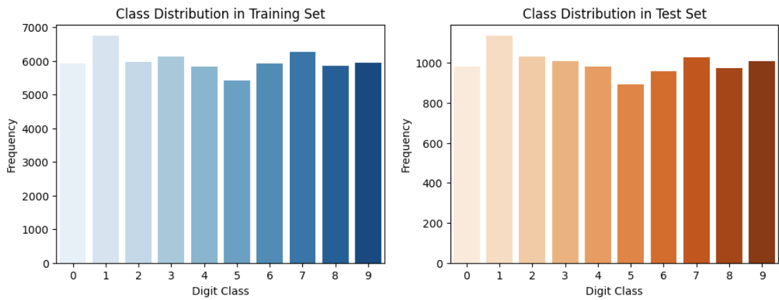
Exploratory Data Analysis
The plot shows the distribution of digit classes (0-9) in a training dataset, with each class having a relatively similar frequency, indicating a fairly balanced dataset.

Slide 7
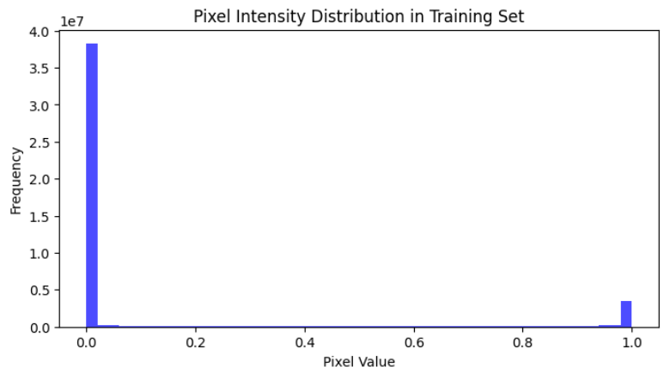
Exploratory Data Analysis
The pixel intensity distribution shows that MNIST consists primarily of black background (0) and white handwritten strokes (1), with minimal mid-range values, ensuring the dataset does not need to be corrected for noise.

Slide 8
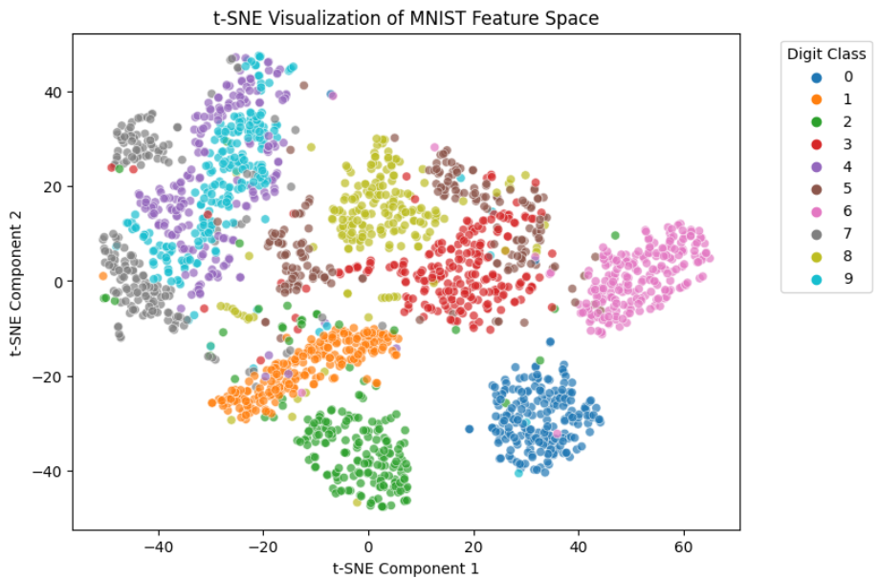
Exploratory Data Analysis
The t-SNE plot reveals that while most digit classes form distinct clusters, some visually similar digits exhibit overlapping regions, suggesting that a simple classifier may not achieve high classification accuracy.

Slide 9
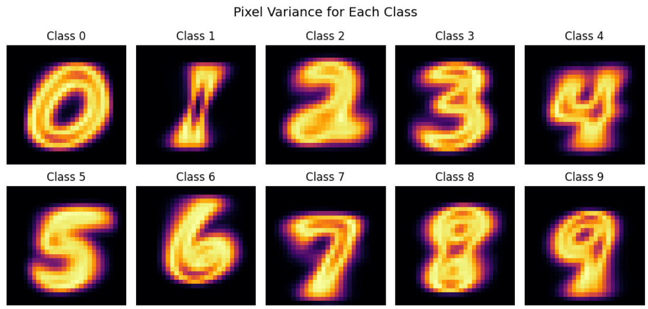
Exploratory Data Analysis
This plot visualizes the variation in pixel intensity within each digit class. Digits like 4 and 7 show high variance due to differing handwriting styles, which could make them more challenging for models to classify accurately.

Slide 10
Objectives
Focus of Study Comparing Regularization-Based, Replay-Based, and Architectural methods under Task-IL and Class-IL settings
Variables to Be Measured
Accuracy Retention, Forgetting Rate, Computational Efficiency
Steps to Be Involved Data Preparation, Exploratory Data Analysis (EDA), Forgetting Analysis, Model Implementation, Training Across Learning Scenarios, Performance Evaluation & Comparison, Inference & Conclusion
Limits of the Study This is a comparative analysis focused on basic continual learning methods. It does not introduce new techniques and excludes Domain-IL due to its reliance on more advanced approaches like meta-learning.

Slide 11
Related Work
Base Paper
Title: Three Scenarios for Continual Learning
Author(s): Gido M. van de Ven & Andreas S. Tolias
Journal: NeurIPS Continual Learning Workshop (2018)
Year of Publication: 2019
Methodology:
Defined three continual learning scenarios: Task-IL, Domain-IL, Class-IL.
Compared different regularization, replay, and architectural methods on Split-MNIST and Permuted-MNIST benchmarks.
Used extensive experimental evaluation to assess method effectiveness across different scenarios.
Notes:
Incremental Learning
Task-IL: The model is explicitly given task identity and only classifies among the classes for that specific task. Each task is treated independently.
Domain-IL: The model is not given task identity and must classify from all possible classes in each task. However, tasks share the same label space, differing only in input characteristics (e.g., rotation, noise, color, etc.).
Class-IL: The model is not given task identity and must classify from all classes seen up to that point in a single unified output layer. Each task introduces new classes, and the model must integrate them into a growing classifier.

Slide 12
Proposed Methodology
Data Preparation
Exploratory Data Analysis
Analysis of Catastrophic Forgetting
Performance Evaluation
Training Across Learning Scenarios
Model Implementation
Conclusion
Notes:
Forgetting analysis using vanilla sgd, performance over time task-IL
Train models using methods on the two scenarios task il and class il

Slide 13
Proposed Methodology
Mitigation Techniques to be Compared:
Regularization-Based Methods → L2-regularization, Elastic Weight Consolidation (EWC), Synaptic Intelligence (SI) (penalize weight updates to retain past knowledge).
Replay-Based Methods → Naïve Rehearsal, Experience Replay (stores and reuses past task data during training).
Architectural Methods → PackNet (freezes weights, allocates separate network parameters for different tasks, preventing interference).
Incremental Learning Scenarios:
Task-Incremental Learning (Task-IL) → Task identity is provided, allowing separate classification for each task.
Class-Incremental Learning (Class-IL) → Task identity is unknown, requiring a single classifier for all previously seen classes.
Baseline for Comparison:
Vanilla Stochastic Gradient Descent (SGD) → Train without any mitigation techniques to observe the extent of catastrophic forgetting.

Slide 14
Methods
Regularization-Based Methods (effective for Task-IL scenarios):
L2 Regularization: Adds a penalty to the loss function based on the magnitude of the weights, discouraging large changes that might disrupt previously learned patterns.
Elastic Weight Consolidation (EWC): Identifies and protects the most important weights for past tasks by penalizing changes to those weights, allowing the network to adapt to new tasks while maintaining critical knowledge.
Synaptic Intelligence (SI): Estimates the importance of each weight for past tasks based on how much it contributes to changes in the loss, and then penalizes changes to those important weights during learning of new tasks.
Replay-Based Methods (effective for Class-IL scenarios):
Naïve Rehearsal: Interleaves training on new task data with a subset of data from previous tasks, allowing the model to revisit and reinforce past knowledge.
Experience Replay: Stores samples from past tasks in a replay buffer and randomly samples from this buffer during training on new tasks, simulating a continuous stream of experience.
Architectural Methods (effective for Task-IL scenarios):
PackNet: Dynamically allocates and freezes parts of the network for each task, effectively creating separate sub-networks that prevent interference between tasks.

Slide 15
Dataset
Source of the Dataset: Yann LeCun, Corinna Cortes, Christopher J.C. Burges. "The MNIST Database of handwritten digits". http://yann.lecun.com/exdb/mnist/
No. of Observations: Training Samples: 60,000
Test Samples: 10,000
Column/Feature Details: Input Shape: (1, 28, 28)
No. of Classes: 10 (0-9 digits)

Slide 16
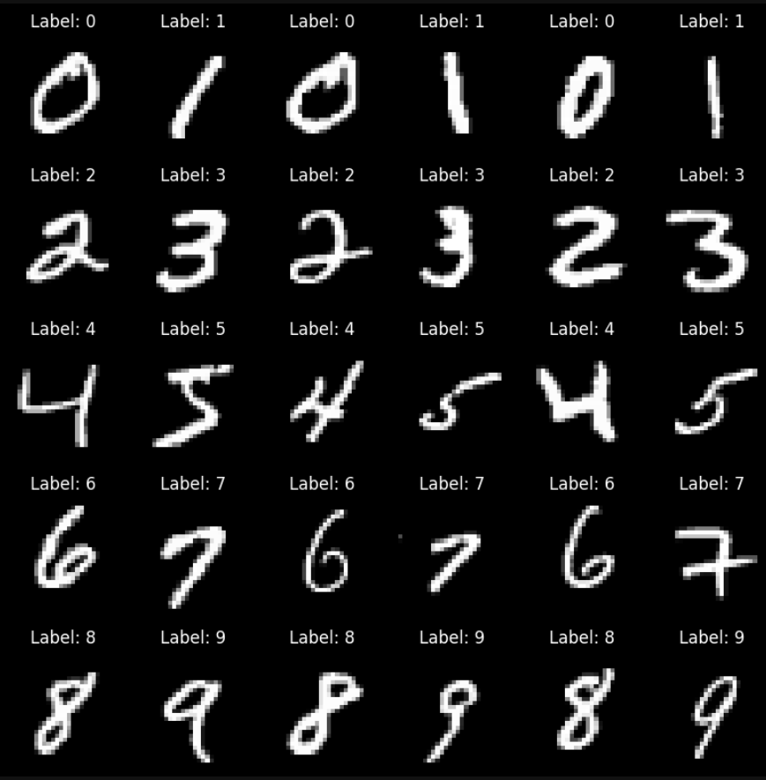
Dataset
Screenshot of the dataset:

Slide 17
Results and Discussion
Methodology (Vanilla SGD):
Baseline Training: A simple neural network trained sequentially on five binary classification tasks from Split-MNIST.
Optimization: Used Stochastic Gradient Descent (SGD) with cross-entropy loss and a learning rate of 0.01.
Training Setup: Each task trained for 5 epochs, and after each task, the model was evaluated on all previously learned tasks to measure forgetting.
Evaluation Metrics: Measured accuracy retention over time to observe the impact of catastrophic forgetting.
Expected Outcome: Performance on previous tasks decreases as new tasks are learned, demonstrating the forgetting effect.

Slide 18
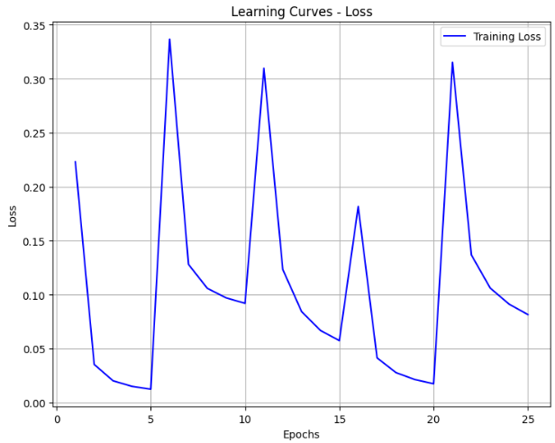
Results and Discussion
The spikes in loss coincide with transitions in training between tasks. The decreases then show how the model adapts to the new task.

Slide 19
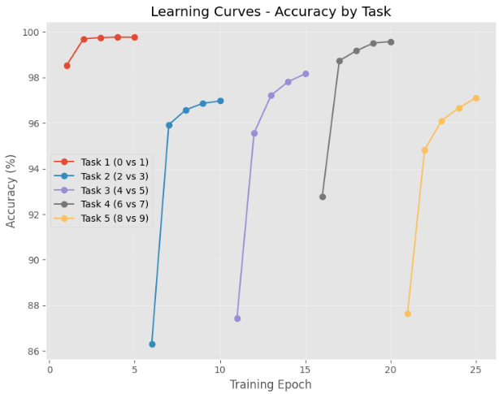
Results and Discussion
The graph shows how the model adapts to learn to classify for the current task. In each case, the model shows strong performance on the current task.

Slide 20
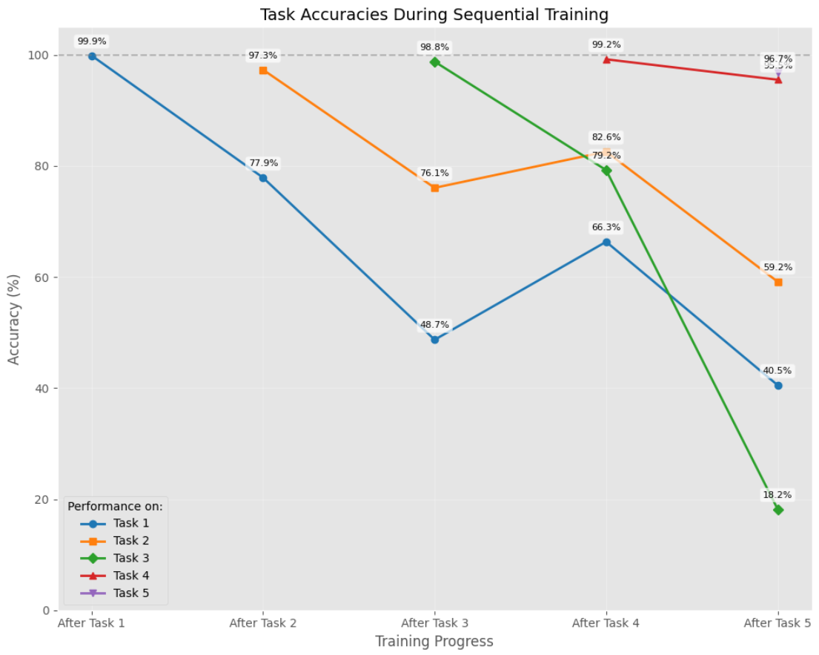
Results and Discussion
In this plot, we can see the effects of forgetting as new tasks as trained. A general downward trend in accuracy is observed after subsequent tasks are trained with a few exceptions of increased accuracy which can be attributed to factors such as positive transfer or randomness.

Slide 21
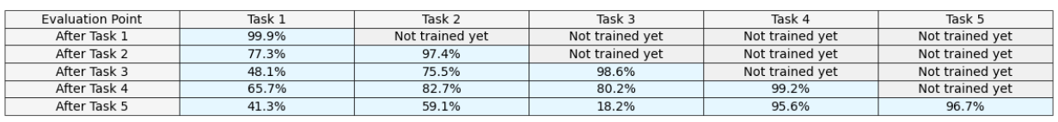
Performance Analysis
Performance Summary

Slide 22
Results and Discussion (Task-IL)
Methodology (Vanilla SGD) – Task Incremental MNIST Baseline :
Task Incremental learning involves learning a sequence of distinct tasks. Permuted MNIST is a benchmark for this scenario, where each 'task' is created by randomly shuffling the pixels of the MNIST dataset. This results in a sequence of related but distinct classification problems. Our baseline uses Vanilla SGD to train a simple neural network sequentially on five such pixel permutation tasks.
Optimization: SGD with cross-entropy loss and 0.01 learning rate.
Training: 5 epochs per task. After each, evaluation on all prior permutation tasks tracks task-specific forgetting.
Evaluation: Task-specific accuracy retention measures catastrophic forgetting in a task incremental setting.
Expected: Performance on older pixel permutation tasks will decrease as new permutations are learned, demonstrating the challenge of task incremental learning with basic SGD. Permuted MNIST represents a scenario where a model must learn new tasks without forgetting old ones, making it a key benchmark for task incremental continual learning.

Slide 23
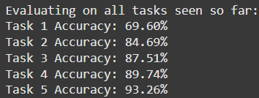
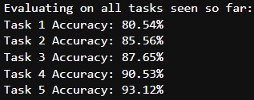
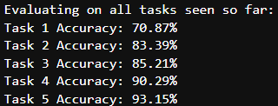
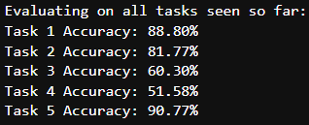
Performance Analysis (Task-IL)
Regularization-based methods
Baseline
EWC
SI
L2

Slide 24
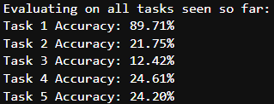
Performance Analysis (Class-IL)
Architectural method
Baseline
PackNet

Slide 25
Results and Discussion (Class-IL)
Methodology (Vanilla SGD) – Class Incremental-MNIST Baseline :
Class Incremental MNIST simulates learning new classes over time. Each 'task' introduces a subset of MNIST digits, building upon previous tasks. Our baseline uses Vanilla SGD to train a simple neural network sequentially on five tasks, each adding two new digit classes.
Optimization: SGD with cross-entropy loss and 0.01 learning rate.
Training: 5 epochs per task. After each, evaluation on all previously learned classes tracks forgetting.
Evaluation: Accuracy on the cumulative set of learned classes measures catastrophic forgetting.
Expected: As new digit classes are learned, performance on previously learned classes will decrease, demonstrating the challenge of class incremental learning with basic SGD. Class Incremental MNIST represents a scenario where a model must learn to recognize new objects without forgetting previously learned ones, making it a key benchmark for continual learning.

Slide 26
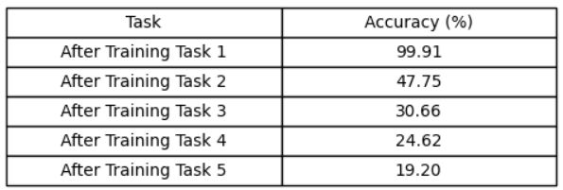
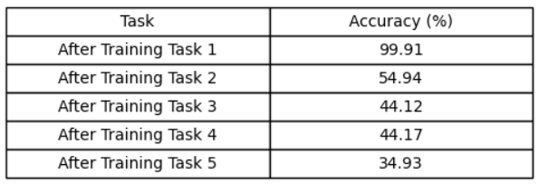
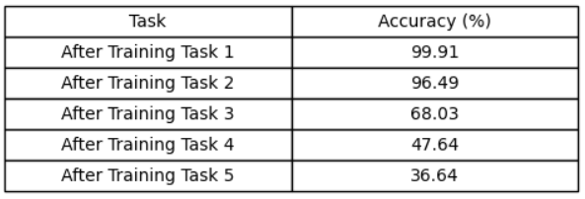
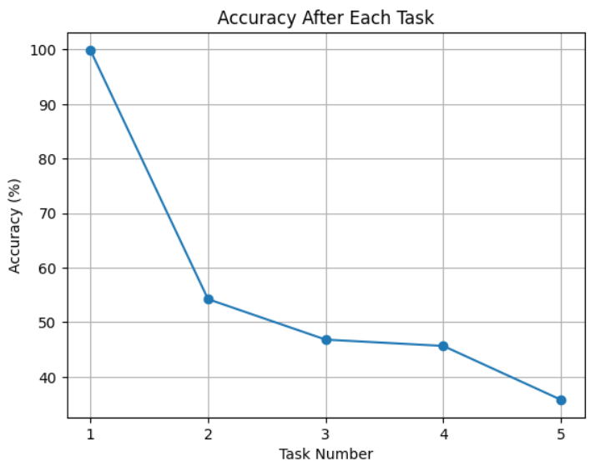
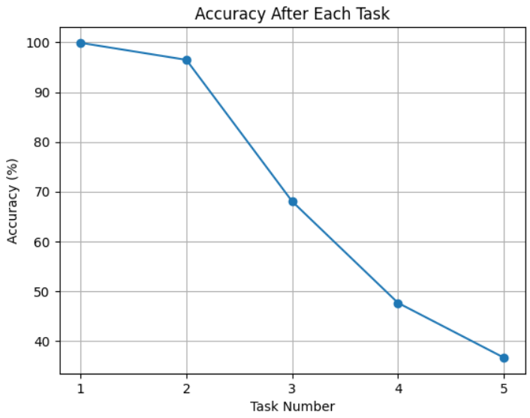
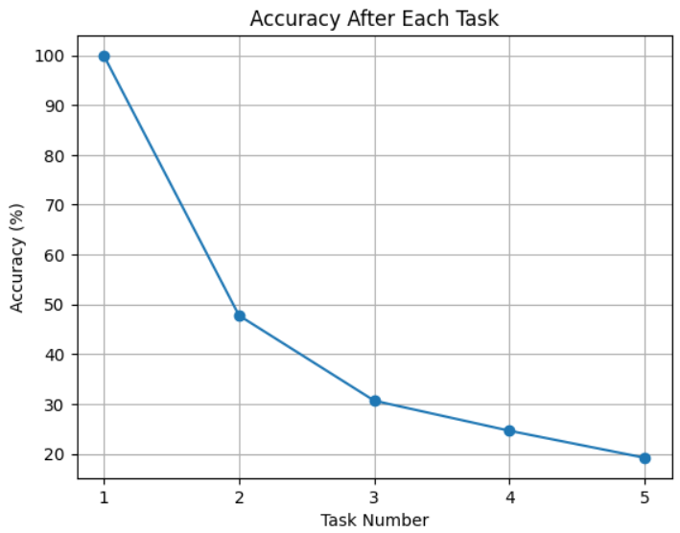
Performance Analysis (Class-IL)
Replay-based methods
Baseline
Naïve Rehearsal
Experience Replay

Slide 27
Conclusion
Task-IL Results:
Regularization Methods:
Elastic Weight Consolidation (EWC) demonstrated the best accuracy retention, likely due to its ability to identify and protect the most critical weights for past tasks.
Synaptic Intelligence (SI) also showed significant improvement, followed by L2 regularization, all surpassing the Vanilla SGD baseline.
Architectural Methods:
PackNet, while promising, presented challenges in achieving a balanced stability-plasticity trade-off. Our implementation tended to strongly favor the initial task, hindering the learning of subsequent tasks. Thus, PackNet's improvement over the baseline was inconclusive.
Class-IL Results:
Replay Methods:
Experience Replay significantly outperformed Naïve Rehearsal. This can likely be attributed to Experience Replay's ability to maintain a diverse and representative buffer of past experiences, allowing for more effective knowledge consolidation.
Both methods demonstrated clear improvements over the baseline.

Slide 28
Future Enhancement
Hyperparameter Optimization: Rigorous tuning of hyperparameters, such as lambda values and learning rates, could lead to even more significant improvements in accuracy retention across all methods.
Hybrid Approaches: Combining different mitigation strategies (e.g., regularization and replay) may yield synergistic benefits, enhancing both stability and plasticity.
Project Structure Optimization: Streamlining the experimental workflow to reduce redundant computations and improve time efficiency for future studies.
Advanced Method Implementation: Expanding the scope to include more advanced continual learning methods that were beyond the project's initial focus.
Enhanced Visualization: Developing more sophisticated visualizations to better illustrate the performance and behavior of the models, facilitating deeper insights into the effectiveness of each mitigation technique.

Slide 29
References
Base Paper:
Van de Ven, G. M., & Tolias, A. S. (2019). Three scenarios for continual learning. arXiv preprint arXiv:1904.07734. https://doi.org/10.48550/arXiv.1904.07734
Link to Paper
Paper I:
Wang, L., Zhang, X., Su, H., & Zhu, J. (2024). A comprehensive survey of continual learning: Theory, method and application. IEEE Transactions on Pattern Analysis and Machine Intelligence, 46(8), 5362-5383. https://doi.org/10.1109/TPAMI.2024.3367329
Link to Paper
Paper II:
De Lange, M., Aljundi, R., Masana, M., Parisot, S., Jia, X., Leonardis, A., Slabaugh, G., & Tuytelaars, T. (2022). A continual learning survey: Defying forgetting in classification tasks. IEEE Transactions on Pattern Analysis and Machine Intelligence, 44(7), 3366-3385. https://doi.org/10.1109/TPAMI.2021.3057446
Link to Paper
Paper III:
Lee, C. S., & Lee, A. Y. (2020). Clinical applications of continual learning machine learning. The Lancet Digital Health, 2(6), e279-e281. https://doi.org/10.1016/S2589-7500(20)30102-3
Link to Paper
Paper IV:
Chen, P. H., Wei, W., Hsieh, C.-j., & Dai, B. (2021). Overcoming catastrophic forgetting by generative regularization. arXiv preprint arXiv:1912.01238. https://doi.org/10.48550/arXiv.1912.01238
Link to Paper

